Slide 1
Cryptography & Network Security
Ms. Regina Esi Turkson (Mrs Regina Esi Segbefia)
Department of Computer Science and Information Technology University of Cape Coast

Slide 2
Disclaimer!
The lecture slides are partially collected from the Internet for educational purpose only. The lecturer does not claim any credit for them and the copyrights belong to the original authors.

Slide 3
Cryptography and Network Security
Chapter 2
Foundations of Cryptography

Slide 4
Summary of Cryptography
Symmetric Encryption
Public Encryption
Digital Signature

Slide 5
Some Basic Terminology
Plaintext - original message
Ciphertext - coded message
Cipher - algorithm for transforming plaintext to ciphertext
Key - info used in cipher known only to sender/receiver
Encipher (encrypt) - converting plaintext to ciphertext
Decipher (decrypt) - recovering ciphertext from plaintext
Cryptography - study of encryption principles/methods
Cryptanalysis (codebreaking) - study of principles/ methods of deciphering ciphertext without knowing key
Cryptology - field of both cryptography and cryptanalysis

Slide 6
Classical Cryptography
Until the 1970s
- exclusively concerned with ensuring secrecy of communication
- relied exclusively on secret information (a key) shared between the communicating parties
Private-key cryptography
- secret-key / shared-key / symmetric-key cryptography

Slide 7
Private-key encryption
key
ciphertext
key
C
k
m
message / plaintext
m := Dec_{k}(c)
c := Enc_{k}(m)
Decryption
Encryption

Slide 8



Private-key encryption
k
c
m
c := Enc_{k}(m)
c
c
k
m := Dec_{k}(c)

Slide 9
Private-key encryption
Traditionally referred to as private/secret/single key cryptography
uses one key
shared by both sender and receiver
if this key is disclosed communications are compromised
also is symmetric, parties are equal
hence does not protect sender from receiver forging a message & claiming is sent by sender

Slide 10
Private-key encryption
A private-key encryption scheme is defined by a message space M and algorithms (Gen, Enc, Dec):
- Gen (key-generation algorithm): generates k
- Enc (encryption algorithm): takes key k and message m ∈ M as input; outputs ciphertext c
- Dec (decryption algorithm): takes key k and ciphertext c ∈ C as input; output m or “error”.
For all m ∈ M and k output by Gen, Dec_{k} (Enc_{k} (m)) = m

Slide 11
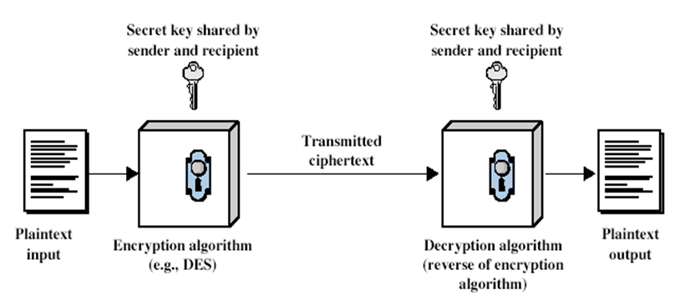
Symmetric Cipher Model

Slide 12
The shift cipher
CONTINUE FROM SLIDE 2 (PDF)

